Slide 1

Analysis of Job Market Trends in the US
Group 6

Slide 2

Project Overview
The "Analysis of Job Market Trends in the United States" project aims to explore and understand the evolving dynamics of the job market, with a specific focus on the data science field. As the demand for data-driven decision-making continues to rise, organizations are increasingly seeking professionals with specialized skills. This project will provide an in-depth analysis of the job market, examining key factors such as high-demand skills, industry trends, geographical hiring hotspots, and the influence of experience level on job postings.

Slide 3
Questions
1. What skills are in the highest demand for data science?
2. Which industries are in most demand?
3. What locations are hiring the most?
4. How do market trends compare over time?
5. What factors influence salary in todays job market?

Slide 4
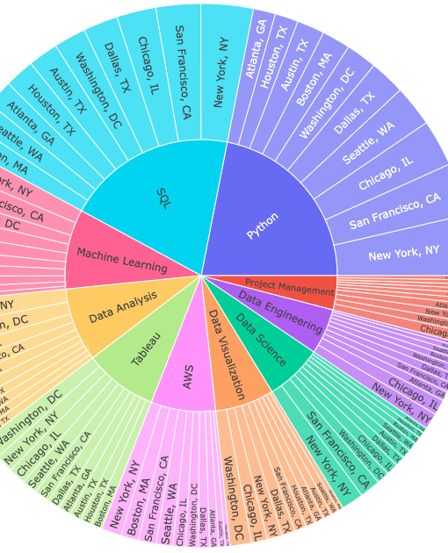
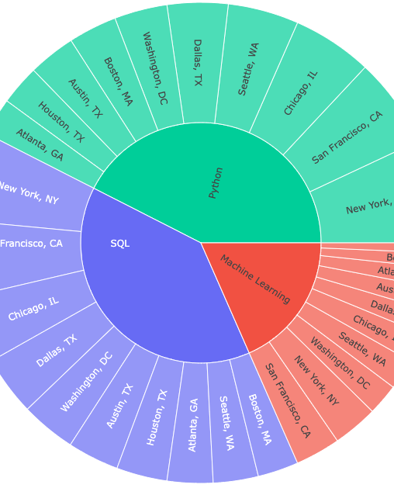
What skills are in the highest demand for data science?
Top 3 Skills in Demand:
Python 21.9%
SQL 20.1%
Machine Learning 9.4%
Top Cities for These Skills:
New York, NY: Strong demand for Python and SQL
San Francisco, CA: Strong demand for Python and SQL
Chicago, IL: Also a top location for Python and SQL
Washington, DC: Notable demand for Machine Learning
Notes:
Left: Top 10 skills from top 10 cities in 2024. (4,032 lines of data)
Right: Top 10 skills from top 10 cities in 2024 filtered down to top 3 skills.
High-Demand Skills:
Skills such as Python, SQL, and Machine Learning dominated the job market in 2024 (Associate to Mid-Senior level), with Python and SQL being highly sought after in major cities like New York, San Francisco, and Chicago. This reflects the critical role of programming and data management in data science roles.

Slide 5
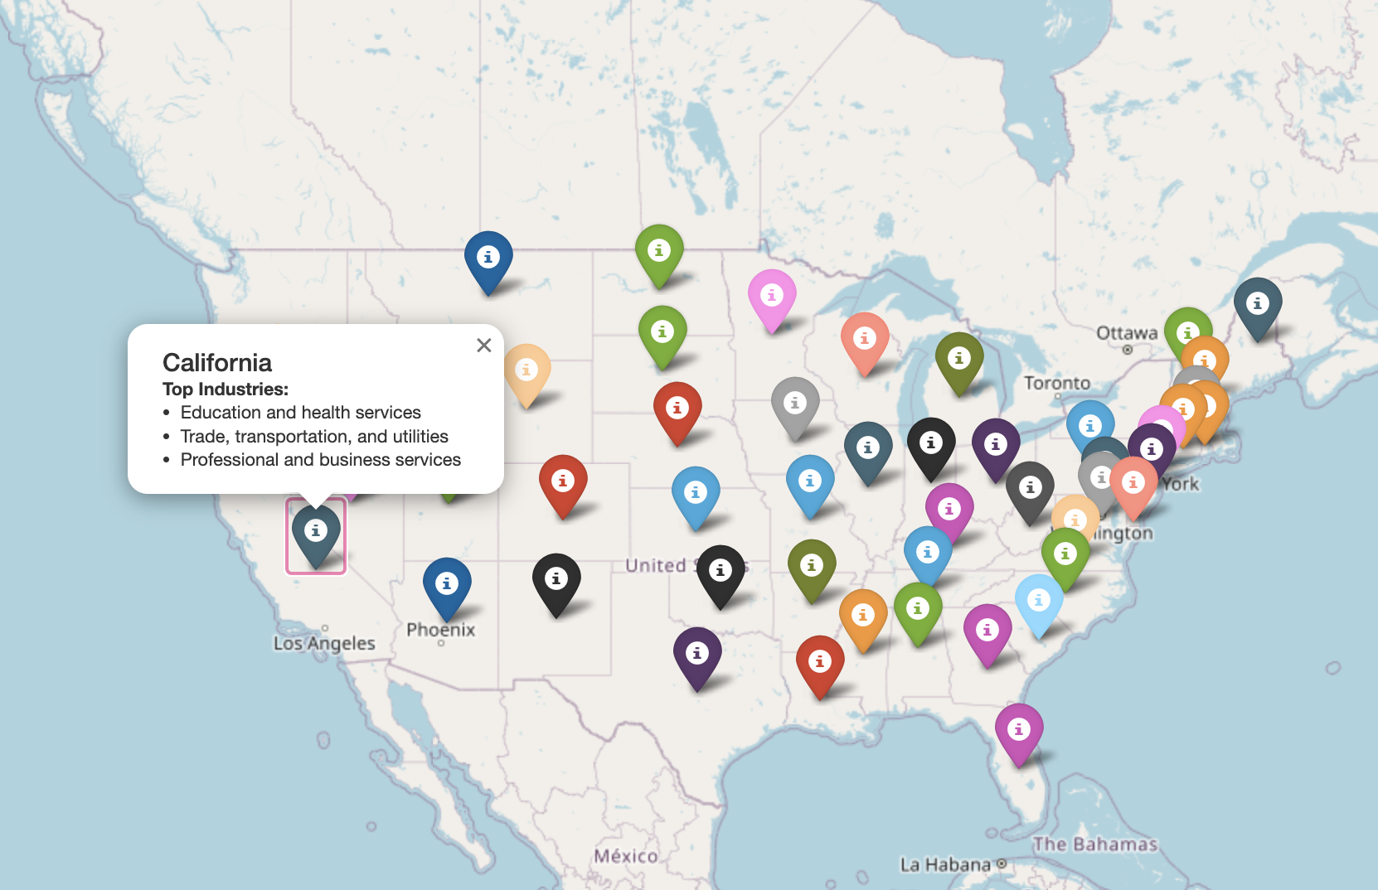
Which industries are in most demand?
Industries in Demand:
Correspond to sectors experiencing growth or increased needs, leading to more job opportunities.
Example Insight:
If 'Healthcare' is a high-demand industry in multiple states, it suggests that healthcare facilities in those areas are actively hiring to meet increasing demand.
Value for Job Seekers:
The map can help job seekers align their career paths with regional industry needs, offering insights into areas with economic growth.
Limitation:
The map highlights broad industry demand rather than specific job titles or individual job openings.

Slide 6
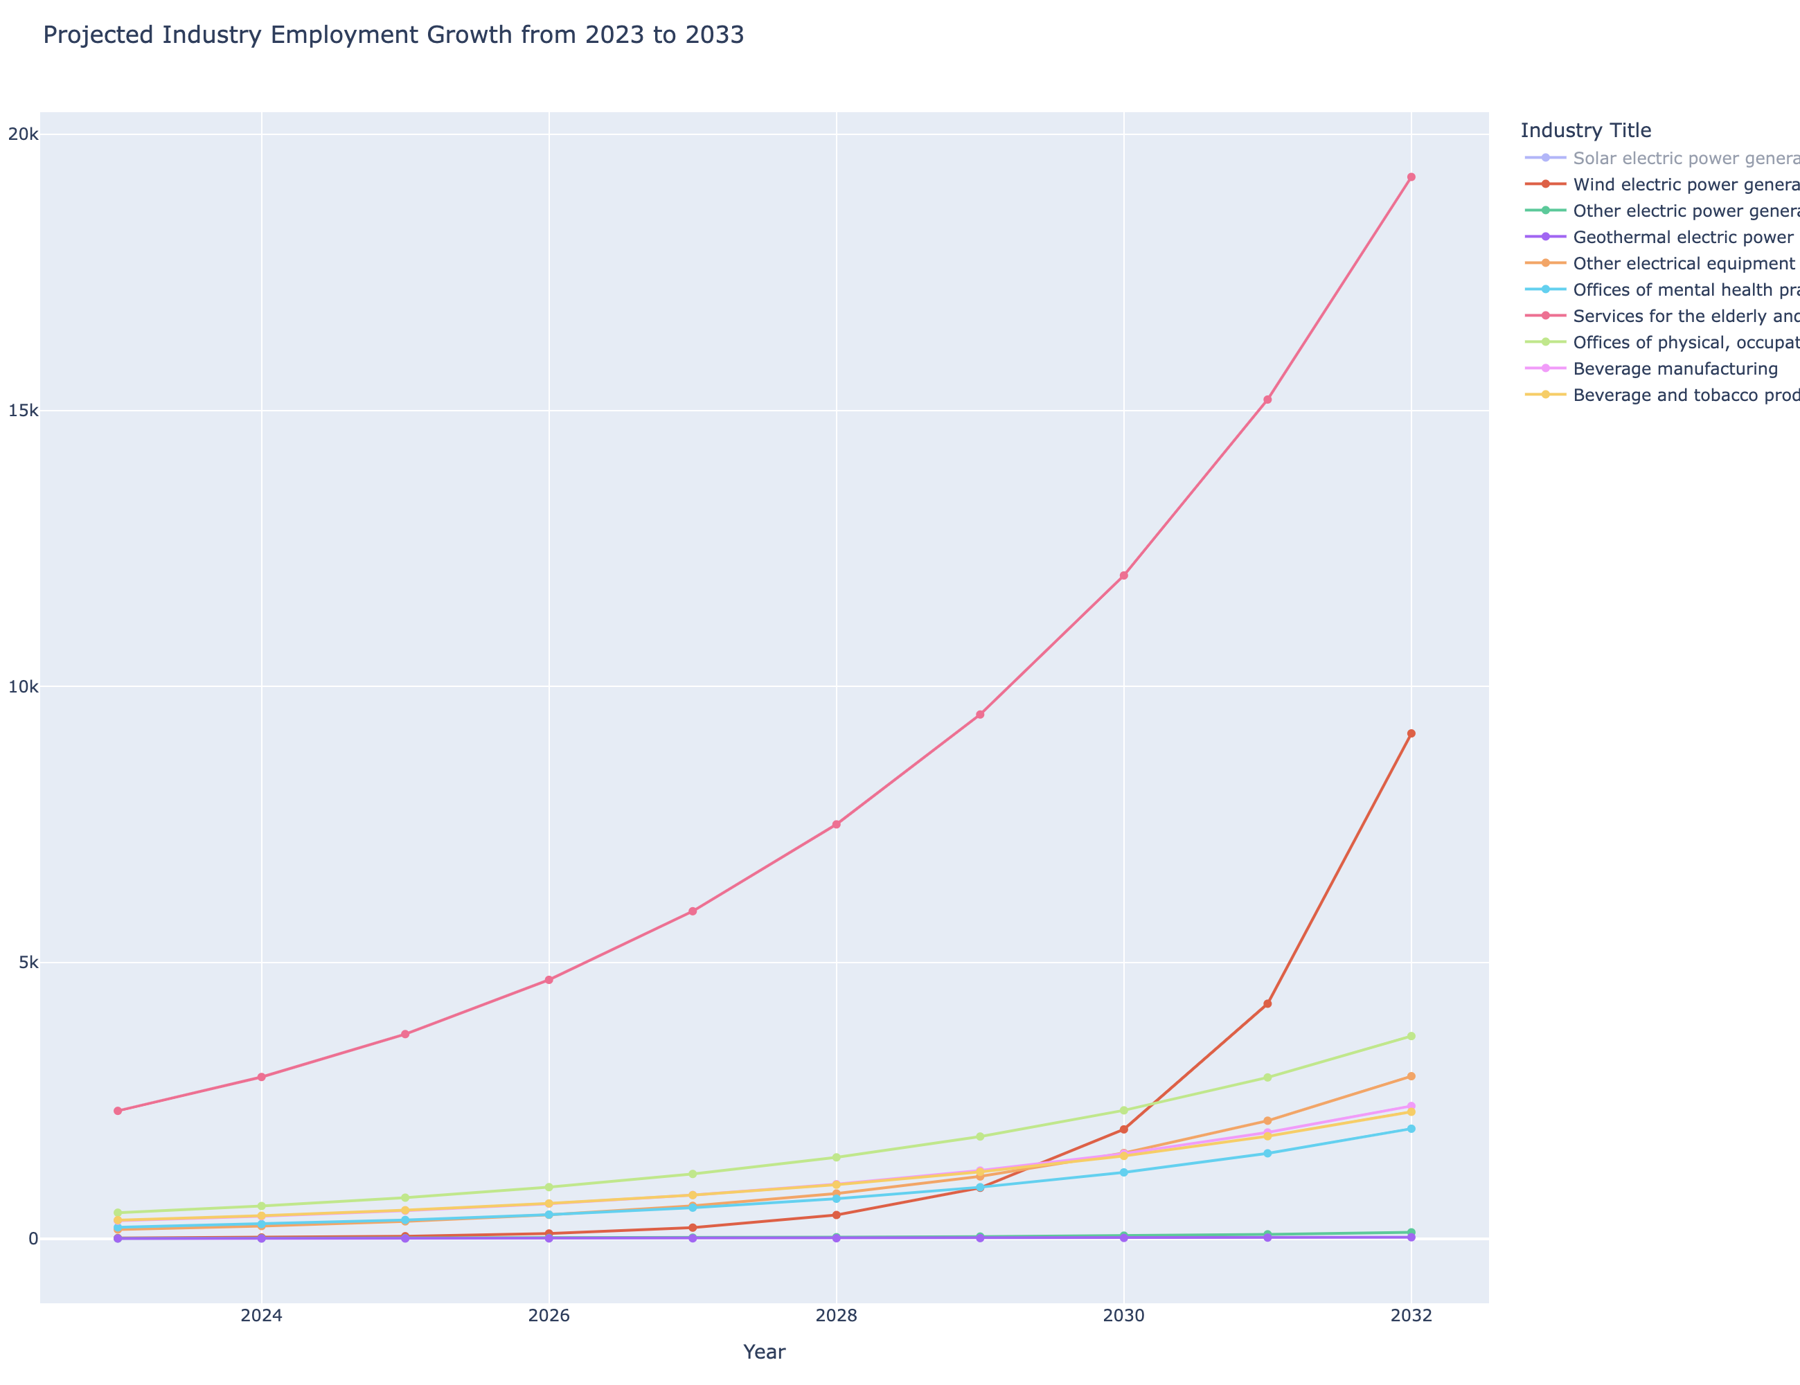
Which industries are in most demand?
Industries in Demand:
The line chart illustrates projected employment growth from 2023 to 2033 for the top 10 fastest-growing industries in the U.S., providing a national overview of job demand trends.
Example Insights:
Renewable energy sectors, such as solar and wind power generation, show steep growth projections, highlighting the increasing demand for clean energy jobs nationwide.
Healthcare-related industries for the elderly are among the top growing industries, aligning with findings from the interactive map, which shows healthcare as a leading industry across multiple states.
· Beverage manufacturing and beverage/tobacco product manufacturing also appear in the top 10, showing consistent demand within the U.S. manufacturing sector.
Value for Job Seekers:
· Together with the map, this line chart provides both state-level and national perspectives on industry demand.

Slide 7
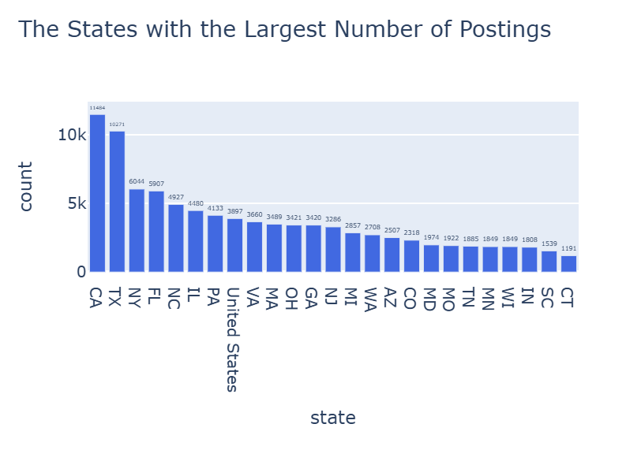
What locations are hiring the most?

Slide 8
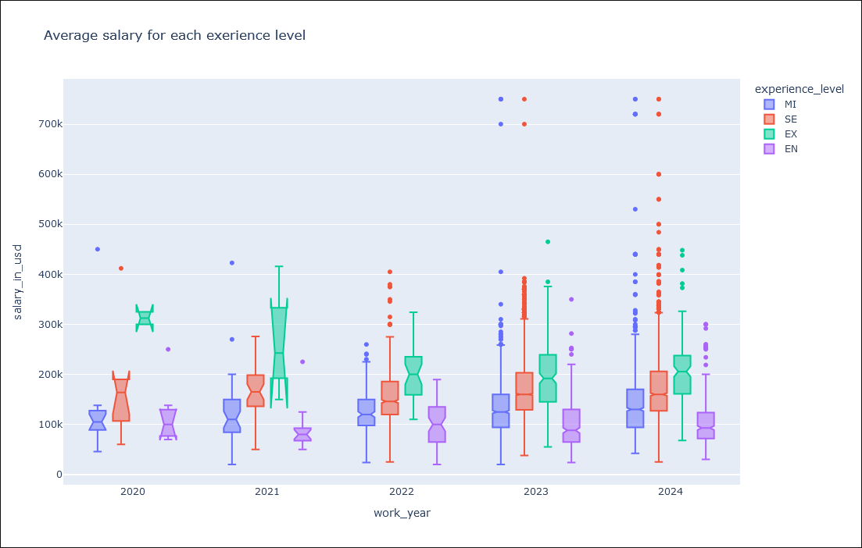
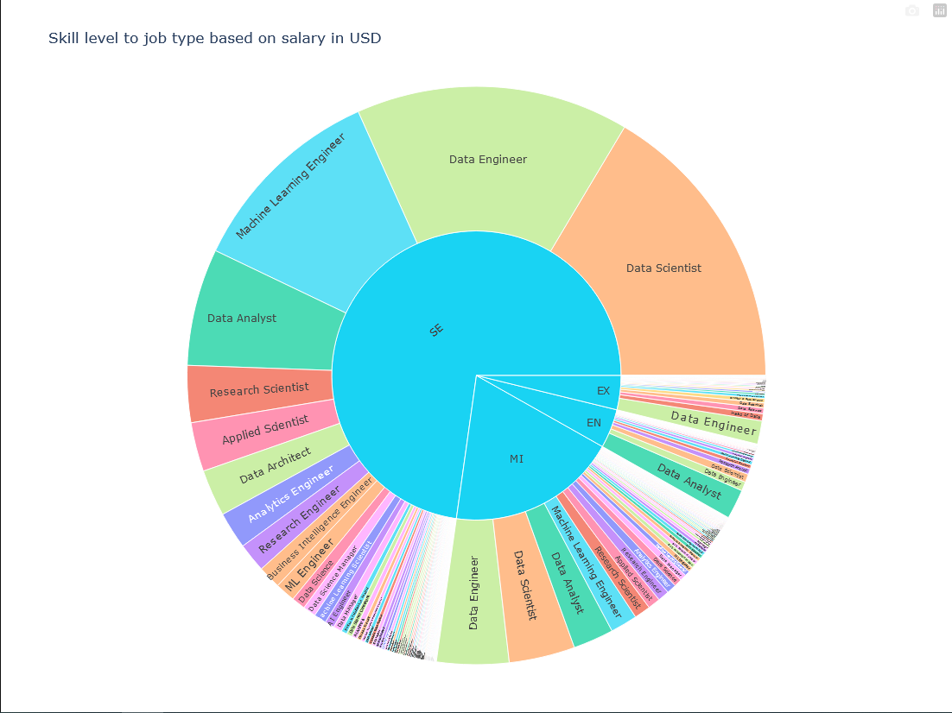
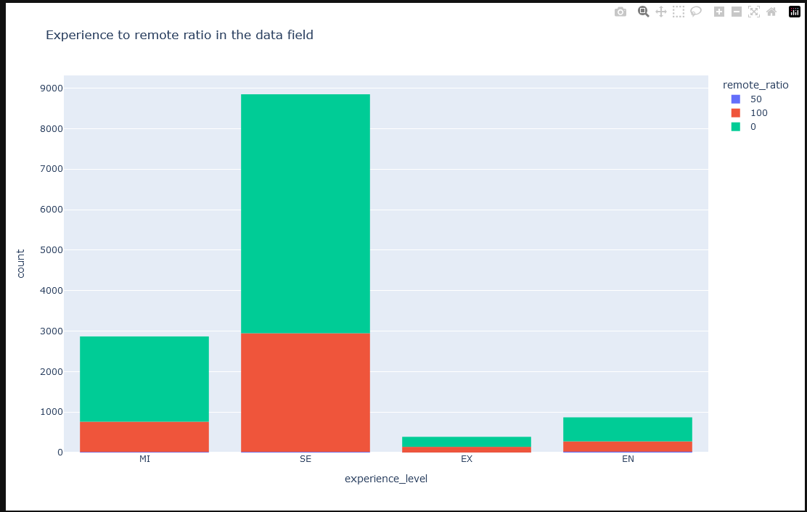
How do market trends compare over time?
The box plot show that executive, senior, and mid level average salary increased over year while entry level was staggered over the years.
Over 4 years the bar graph shows a lot more people work in office compared to remote.
The sunburst chart shows that senior level people make most of the work force, and their fields are data scientist, data engineering, and machine learning engineering.

Slide 9
How do market trends compare over time?
2020 (Covid Years):
Executives and senior-level professionals earned more on average compared to previous years.
Mid-Level Professionals:
Average earnings have been steadily increasing each year from 2020 to 2024.
Entry-Level Professionals:
Average earnings have remained relatively stagnant over the years.
There are larger outliers in 2023 and 2024, indicating occasional spikes in earnings for some individuals.

Slide 10
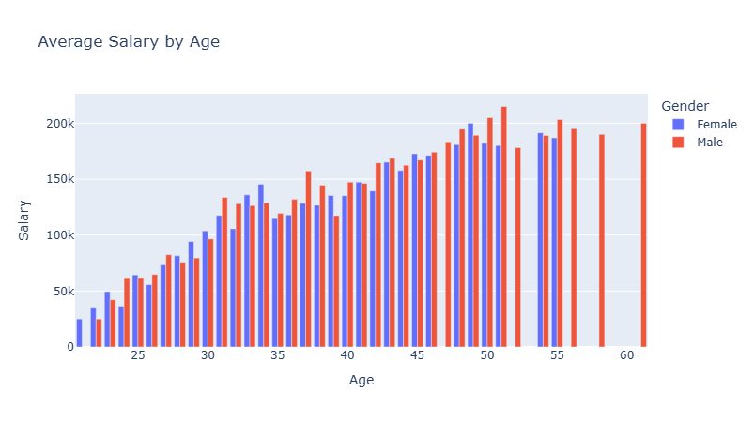
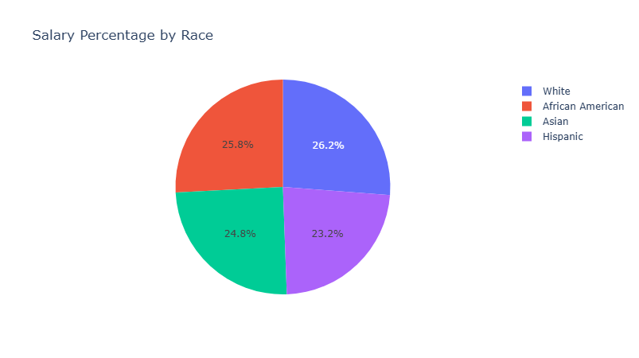
What Factors influence Salary in Todays Job Market?
Age:
The average salary difference between a 25-year-old and a 50-year-old is nearly $150,000.
Experience:
Data shows that individuals with more job experience are significantly more likely to earn higher salaries.
Gender:
Males earn, on average, 15% more than females in the current job market.
Education:
Workers with only a high school diploma earn around $30,000 annually, while those with a PhD earn over $100,000 on average.

Slide 11
Analysis & Conclusion
The demand for data science skills remains robust, particularly in tech-driven cities and growing industries.
However, while mid-level and senior professionals are benefiting from increasing salaries and job opportunities, entry-level workers face challenges, with stagnant wages and limited access to high-paying roles.
While data science remains a promising field with growing opportunities, entry-level professionals may need to navigate a competitive landscape with careful consideration of education, skill development, and strategic positioning to maximize their career prospects.
This project highlights the dynamic nature of the data science job market and the critical factors influencing career opportunities and compensation in today’s economy.

Slide 12

Thank you

